Slide 1
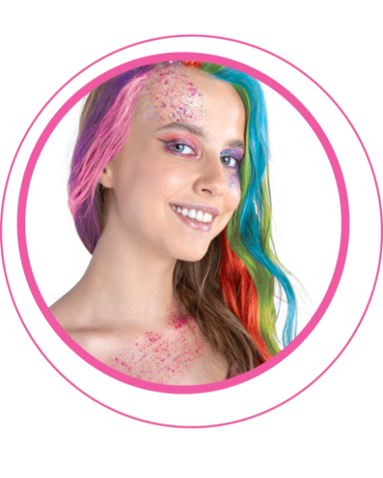

Slide 2
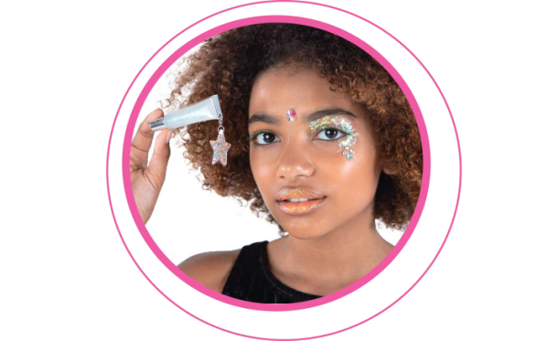
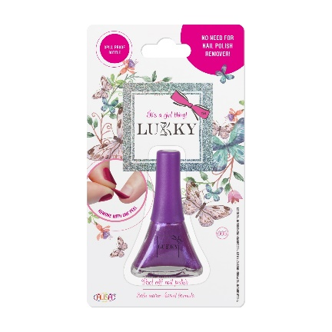
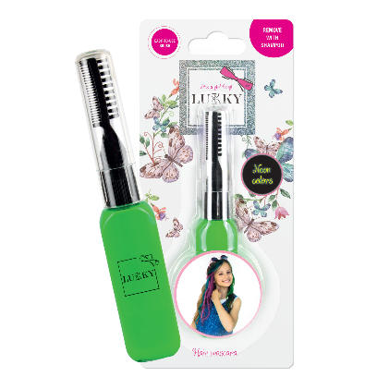
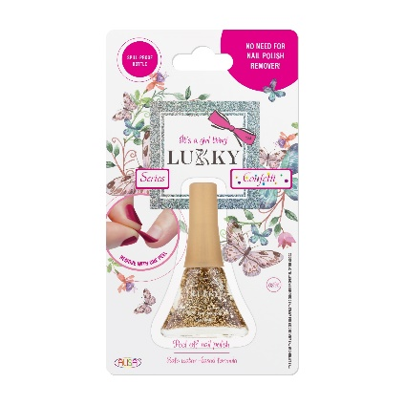
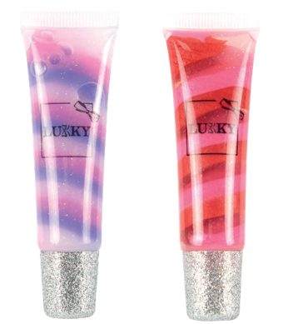
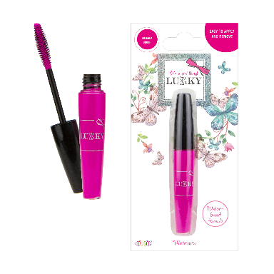
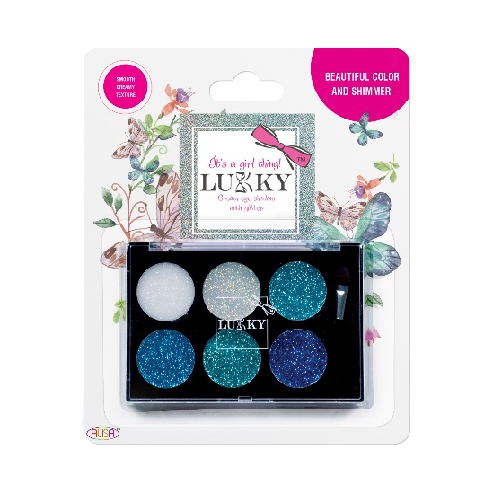
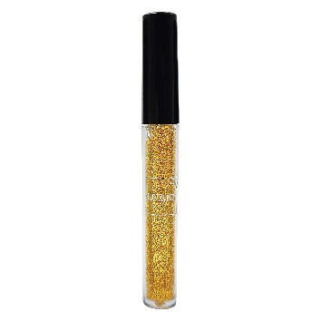
LUKKY Brand Story
LUKKY began in the European market in 2017 with a line of peel-off, water based nail polish. Since then, the brand has grown significantly and now includes a wide selection of various cosmetics items for nails, hair, body, eyes and lips. Due to customer demand, LUKKY has also branched into other categories of accessories, glitter tattoos and more. We pride ourselves in creating something truly unique and different in the beauty market.
We strive to create a unique product line that would appeal to a broad audience of kids, teens and young adults who have an interest in beauty, style and fashion. Our biggest priority is making sure that our products are safe and easy to remove so both children and their parents feel at ease. Given our international success, we are now looking to offer our products to consumers in North America.

Slide 3
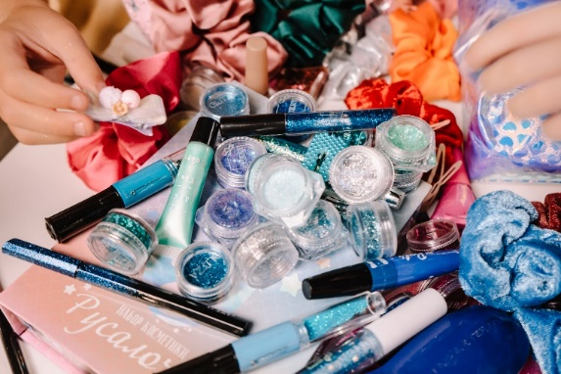
Why choose LUKKY?
Quality:
Impeccable quality standards:
Only the safest FDA-approved ingredients are used;
All products have successfully passed rigorous EU testing applicable specifically for children’s cosmetics (CPSR available, Safety assessment, Micro and stability testing, EN71)
Broad appeal
Targeted to girls aged 5-15, teens, and adults
Easy to remove:
All cosmetics and nail polish can be removed without special chemical removers
Nail polish is peel-off
Price
Competitive price points
Uniqueness
No direct competition in cosmetics market for kids, tweens, teens
Variety
Wide range of products compared to other children’s cosmetics brands
Glamorous and fashionable
Different from the typical “pink princess” craziness in the children’s cosmetics market.
Different from products that look too “childish”.

Slide 4
PREMIUM
YOUNG CHILDREN
TWEENS
TEENS
YOUNG ADULTS
ADULTS
POP-ARAZZI
AFFORDABLE

Slide 5
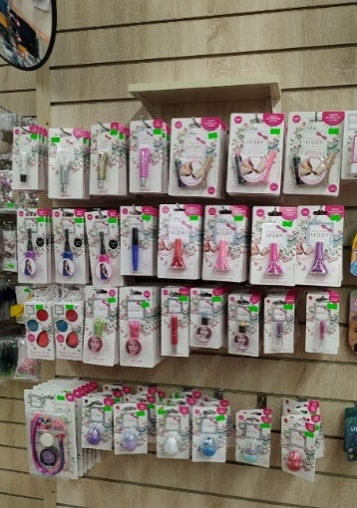
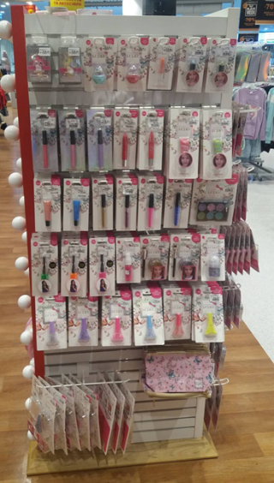
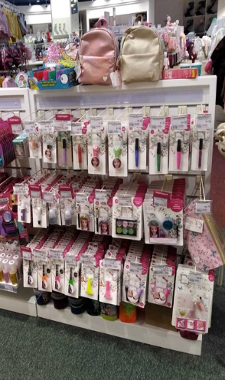
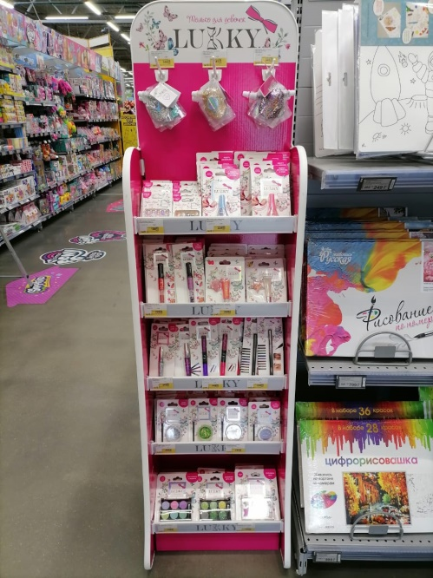
Current Distribution
Retailers we work with
In Europe:
Toy Stores
Cosmetics Stores
E-commerce
Supermarkets and Grocery Stores
Off-price Retail
Pharmacies
Gift Stores

Slide 6
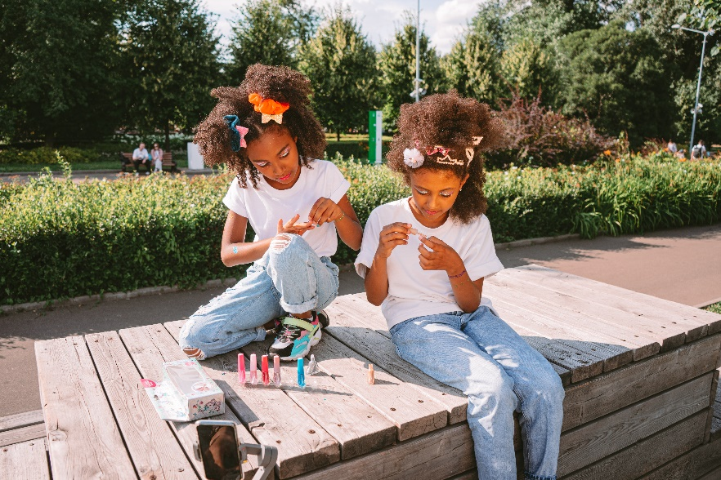
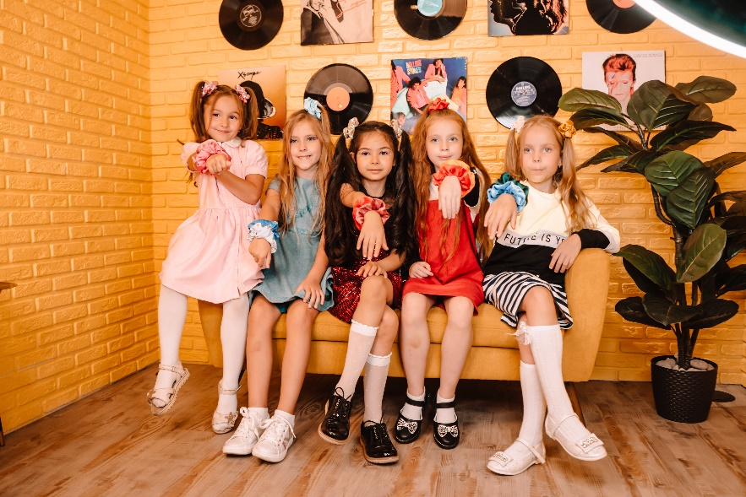
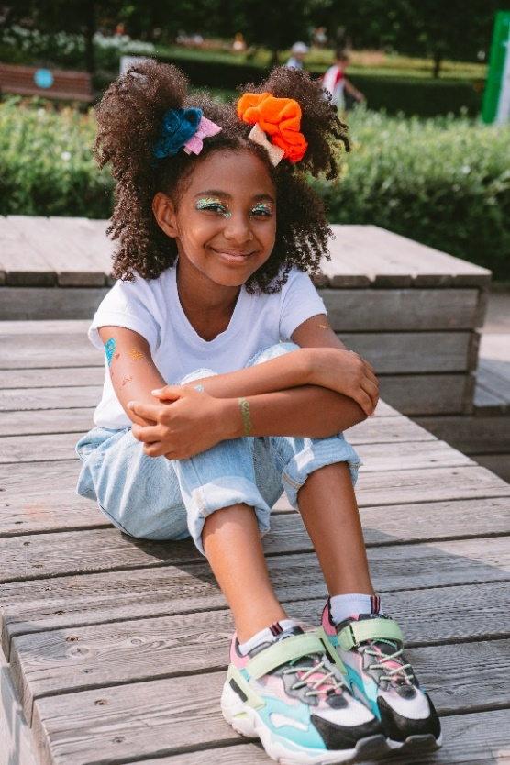
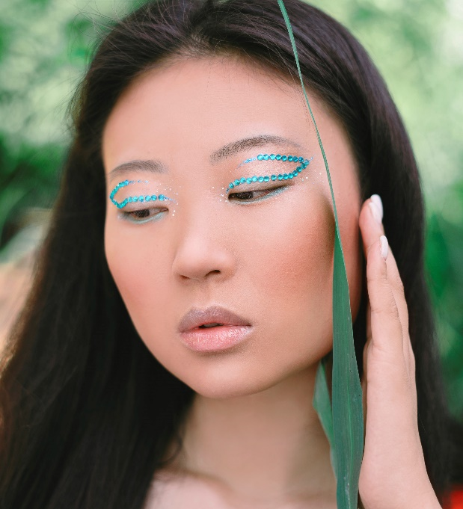
Target Audience
Girls as young as 5 years old, tweens, teens & adults:
Who are striving to be fashionable
Who want to purchase cosmetics "for adults"
Who use social media to search for the latest trends
Who have interest in beauty

Slide 7
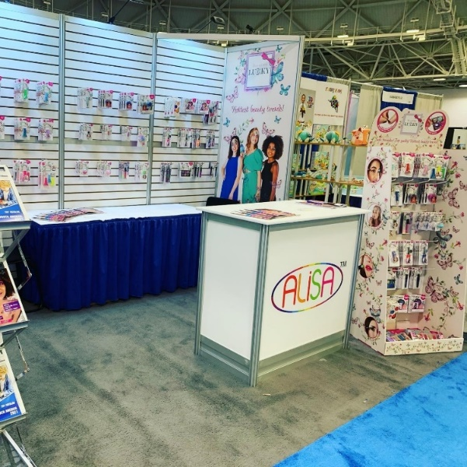
Marketing in the US
Trade Shows:
ASTRA 2021
Philadelphia Gift Show 2021
NY Now 2021
Atlanta Gift Show
Toy Fest West 2022
ASTRA 2022 (planned)
Seattle and Minneapolis Gift Shows (planned)
Cosmoprof North America 2022 (planned)
Social Media plans:
Instagram (lukky.cosmetics)
Youtube
Tik Tok (planned)
Influencers involvement (planned)
Facebook (planned)
Other marketing plans:
Website: https://alisatoys.com/product-category/lukky/
Advertising (planned)
Retail FDSU (currently offering for free with every $500+ order)

Slide 8
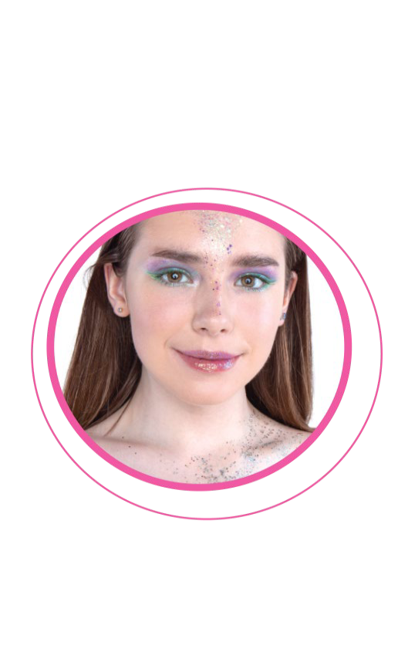
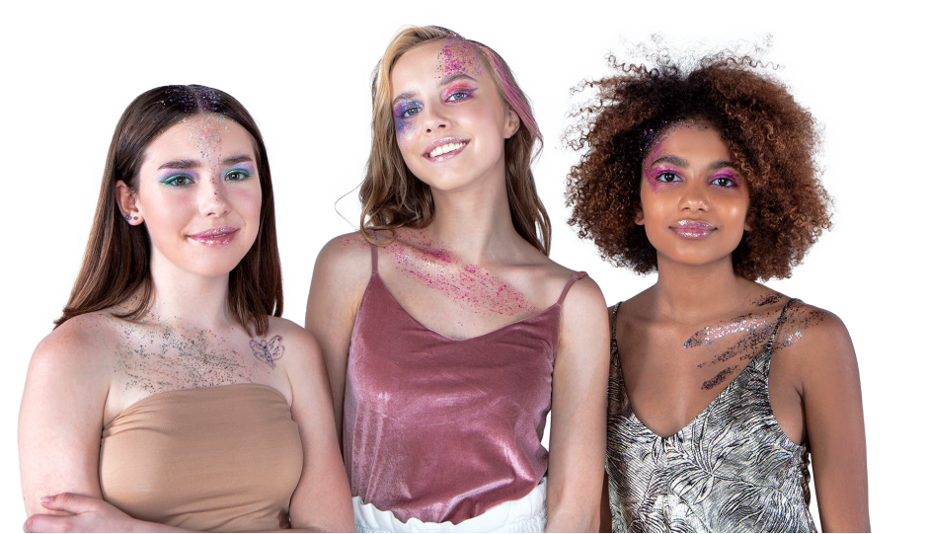

Slide 9
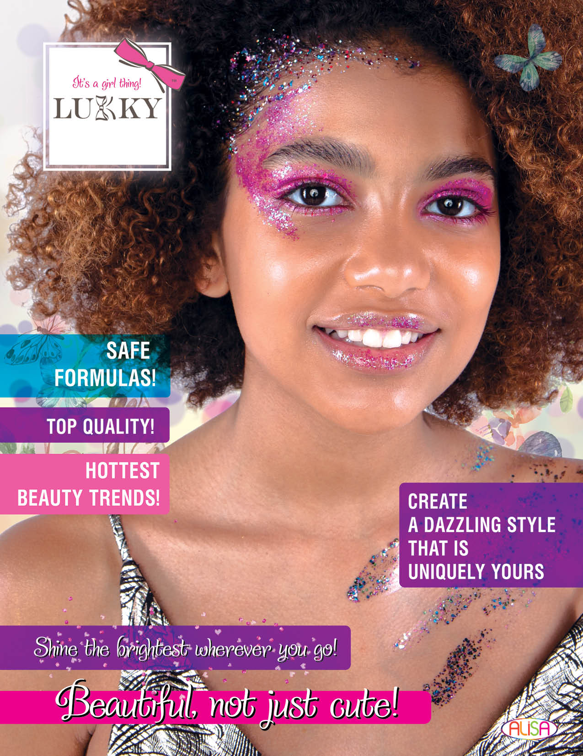
Catalog 2022

Slide 10
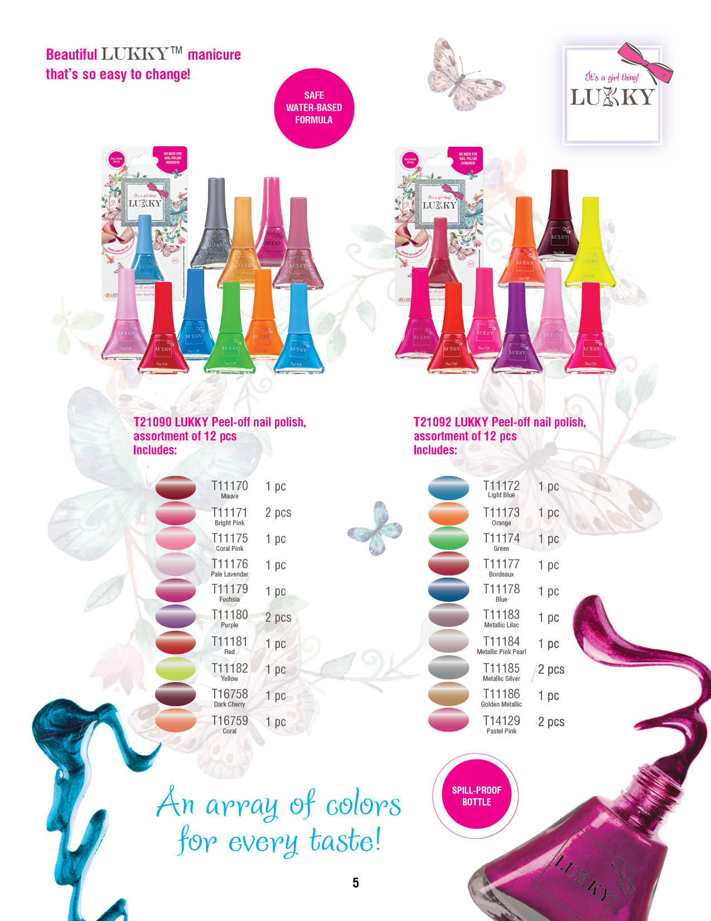
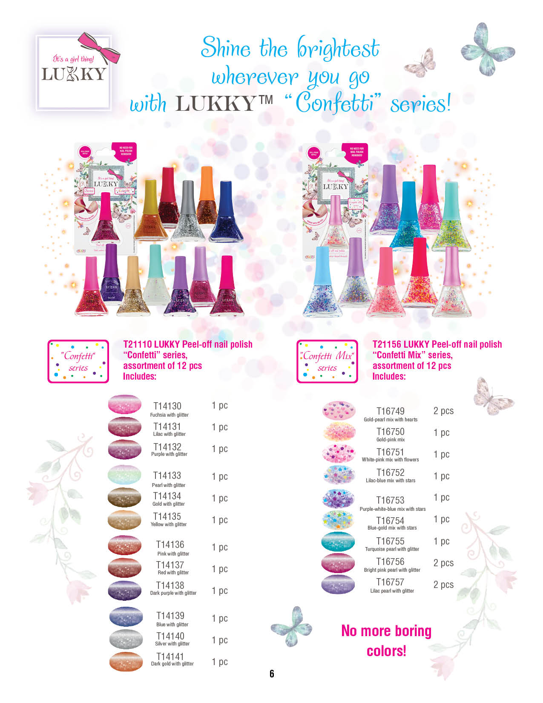

Slide 11
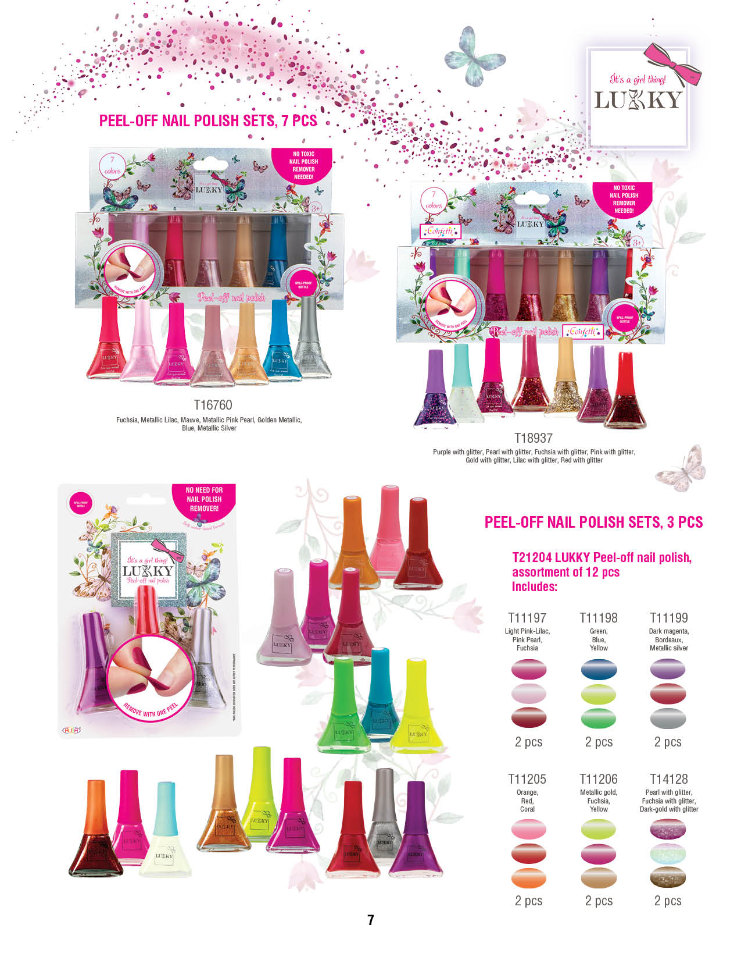
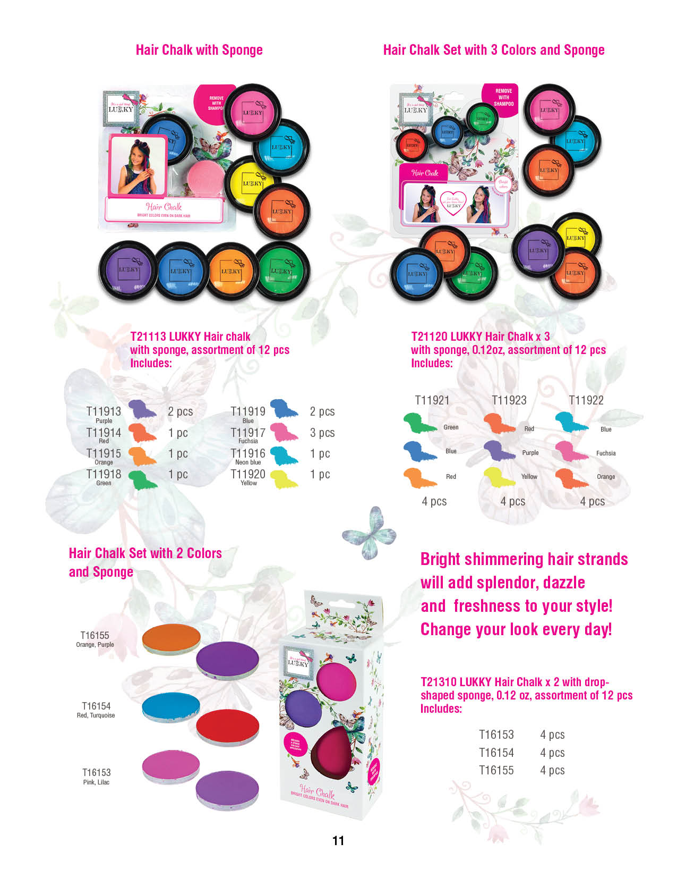

Slide 12
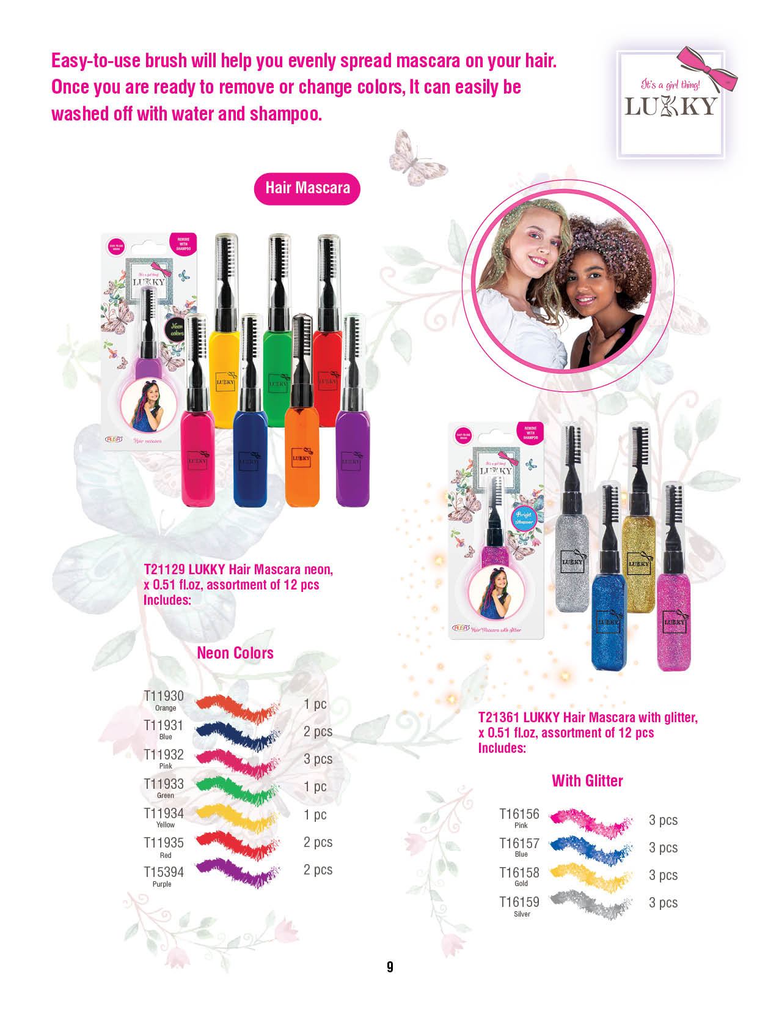

Slide 13
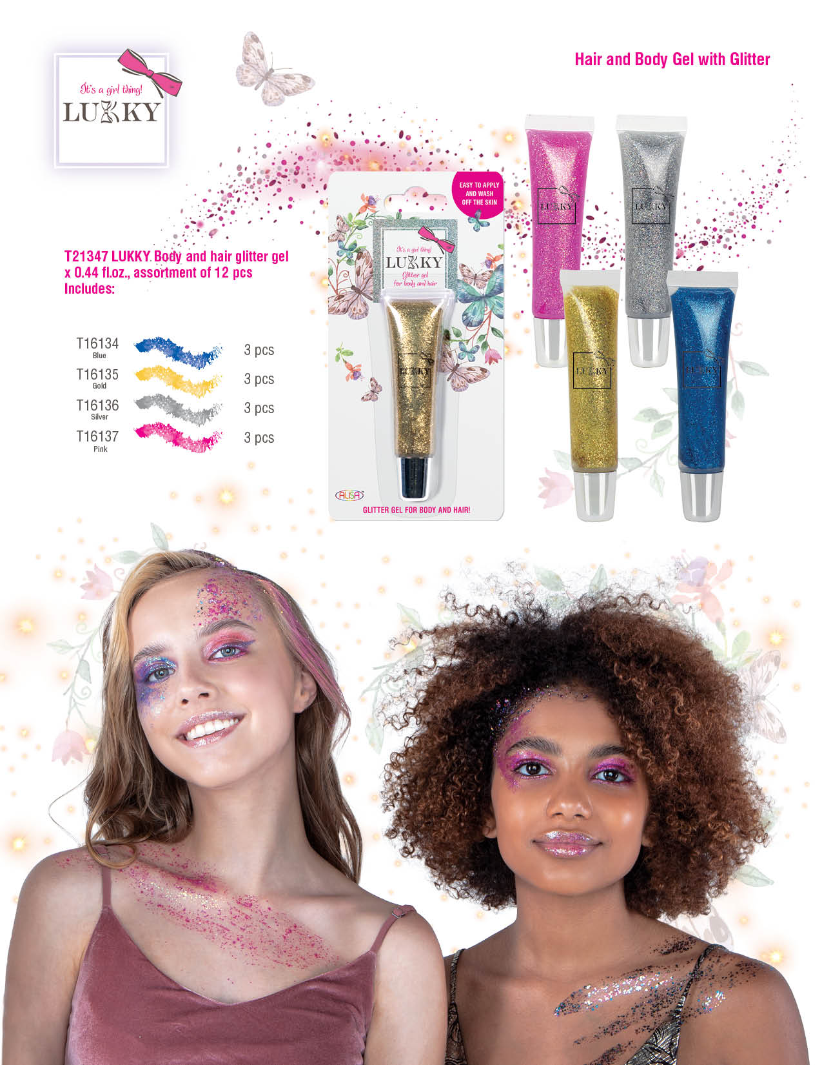
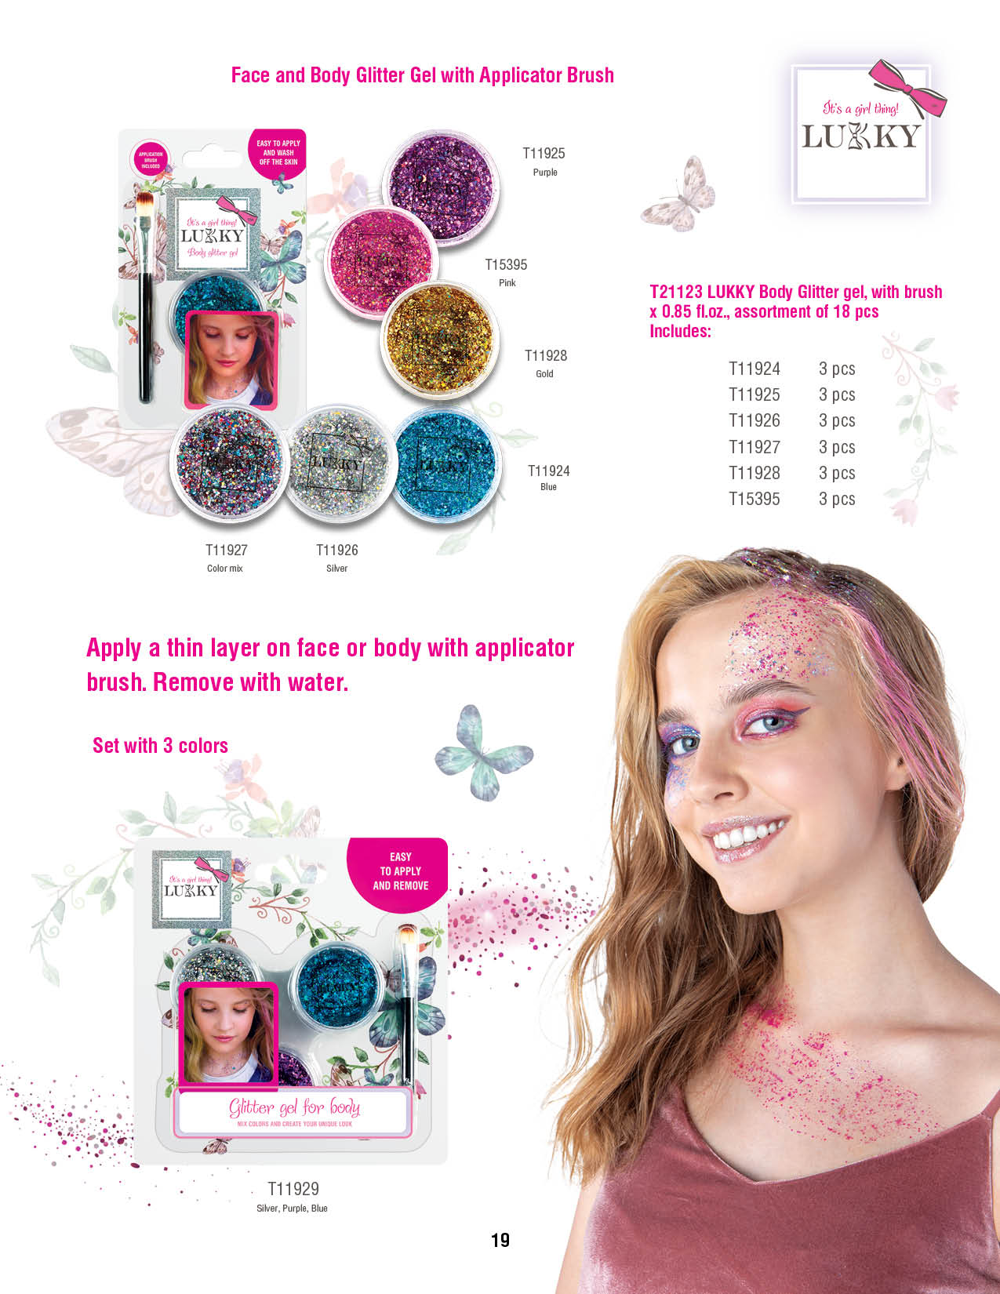

Slide 14
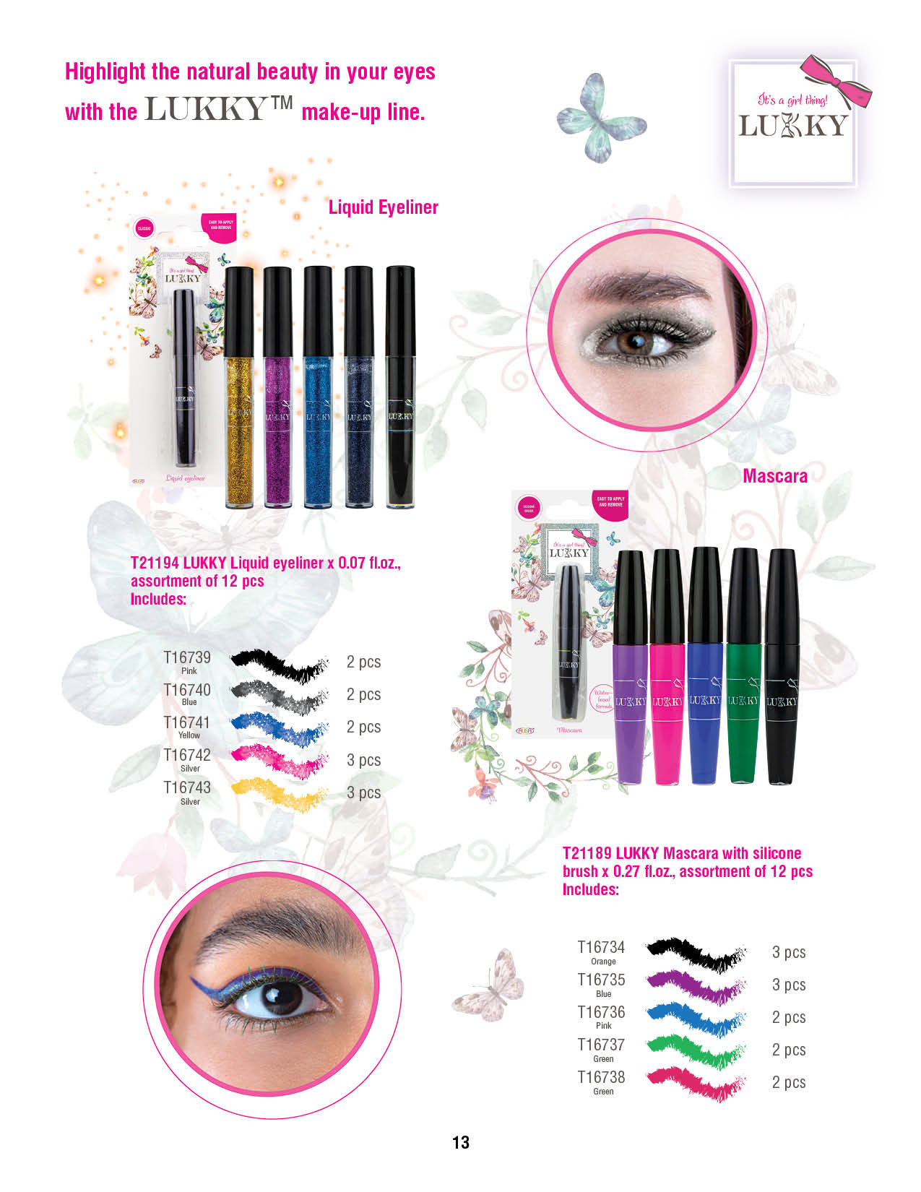
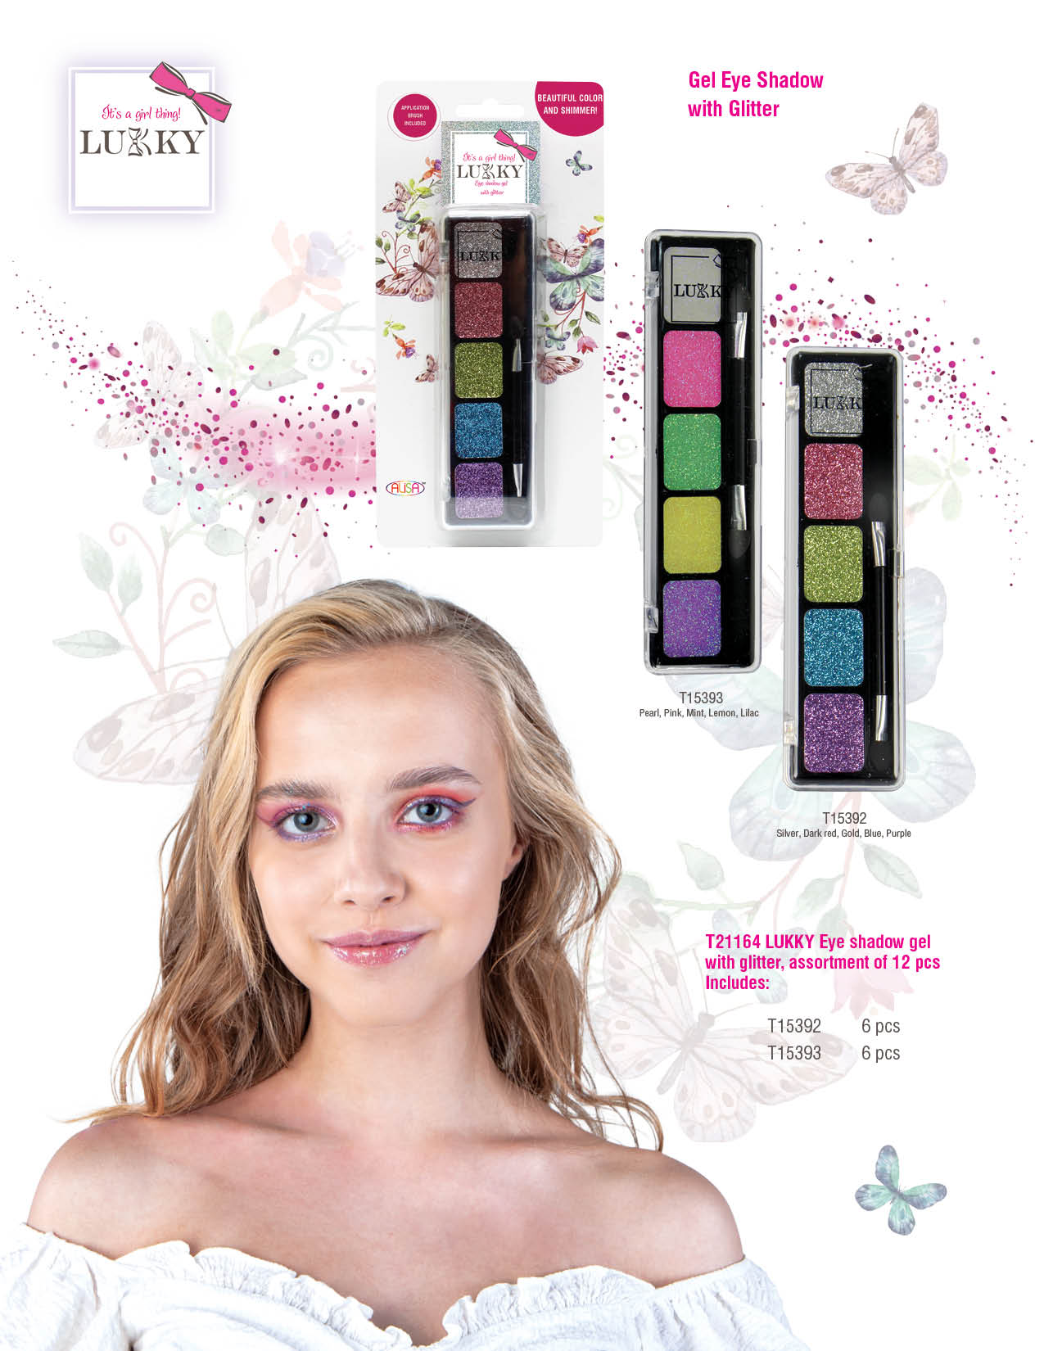

Slide 15
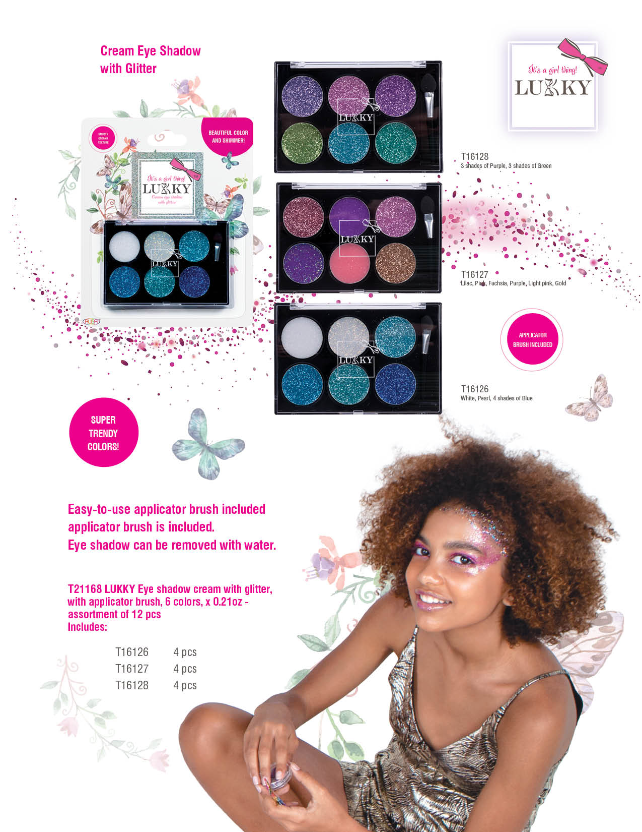
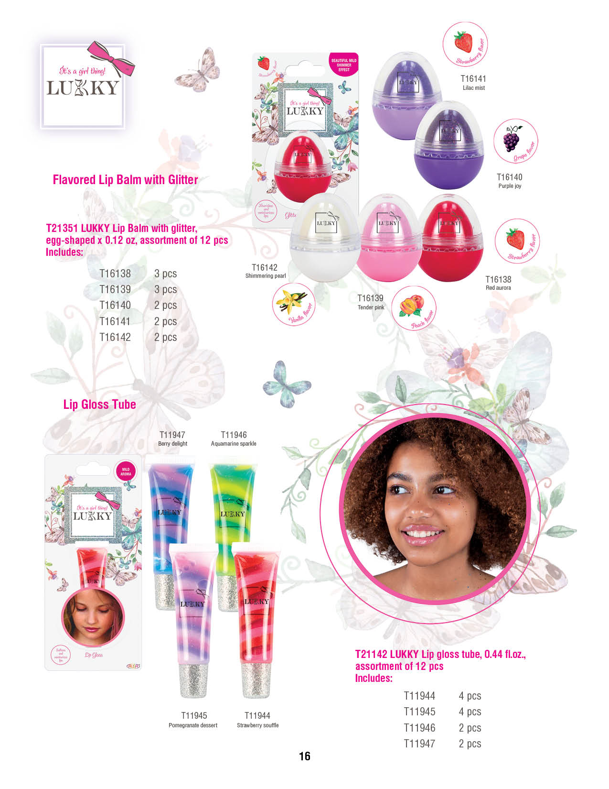

Slide 16
